Slide 1
Cheese Identification

Slide 2
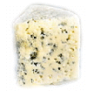
Blue

Slide 3
Brick

Slide 4
Brie/Camembert

Slide 5
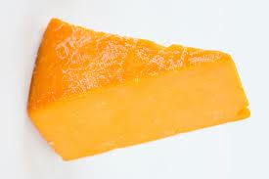
Mild cheddar

Slide 6
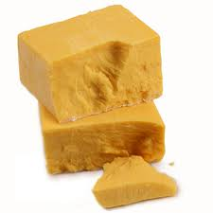
Sharp Cheddar

Slide 7
Colby

Slide 8
Cream/Neufchatel

Slide 9
Edam/Gouda

Slide 10
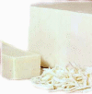
Monterey Jack

Slide 11
Mozzarella

Slide 12
Muenster

Slide 13
Provolone

Slide 14
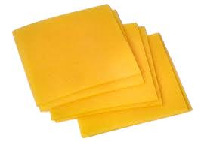
Processed American

Slide 15
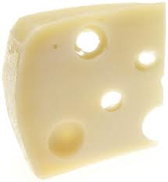
Swiss

Slide 16
Feta

Slide 17
Romano

Slide 18
Havarti

